Slide 1
What You Need to Hear about Hearing Health
Insert Name and Contact Information for Practice

Slide 2
Facts Worth Hearing
It is estimated that approximately 38 million American adults have a hearing loss
1 in 8 people 12 years of age or older has a measurable hearing loss in both ears
Hearing loss is the third most common chronic condition for adults over age 65 years, behind only high blood pressure and arthritis
Insert Your Practice Logo Here

Slide 3
Prevalence of Hearing Loss in the U.S.
Total Adults with HL
Aged 65 – 74 Years
75 Years +
Age is the single best predictor of hearing loss.
38
MILLION
9.5
MILLION
10.2
MILLION
15%
33%
50%

Slide 4
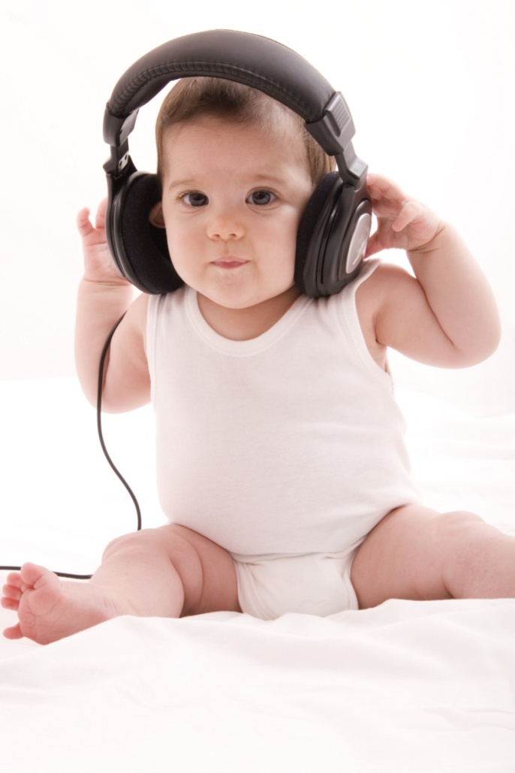
Prevention is Still the Best Cure: H.E.A.R. Strategy
Hold yourself accountable for hearing health
Evaluate your surroundings
Avoid the noise
Remember protection
Insert Your Practice Logo Here

Slide 5
How Do I Know if I Need My Hearing Evaluated?
I often feel like people are mumbling
I have difficulty talking on the phone or listening to the TV
Others complain that I have a hearing problem
I have trouble understanding conversation if there is background noise
Insert Your Practice Logo Here

Slide 6
How Do I Know if I Need My Hearing Evaluated?
I frequently ask others to repeat what they have said to me
I have ringing in my ears
I have a history of ear infections
I experience dizziness
I have a family history of hearing loss
I have a history of exposure to loud noise
Insert Your Practice Logo Here

Slide 7
Diabetes
Social Isolation and Depression
Cognitive Disorders
Hearing Loss is Connected to Other Conditions & Comorbidities
Ototoxic Drugs
Heart Disease
Falls Risk
Tumors and Infections

Slide 8
Common Misperceptions about HL
My type of hearing loss is untreatable
Wearing hearing aids is a sign of old age
With hearing aids, I’ll be able to hear perfectly
Insert Your Practice Logo Here

Slide 9
Frequently Asked Questions
Why is it important to get help for my hearing problem?
What if I don’t think I can afford hearing aids?
What is an audiologist? Why should I choose an audiologist as my hearing healthcare provider?
Insert Your Practice Logo Here

Slide 10
Thank You
Insert Name and Contact Information for Practice

